Slide 1
Computational Thinking, Problem Solving, and Programming
TOPIC 4.0 – Computational thinking
TOPIC 4
A Deep Dive into Lists and Objects

Slide 2

REVIEW REVIEW REVIEW REVIEW REVIEW REVIEW
THE WARM-UP QUESTION
Write a short Python procedure to loop through a list of numbers and print out every even element

Slide 3
REVIEW REVIEW REVIEW REVIEW REVIEW REVIEW
THE WARM-UP ANSWER
def printEven(arr):
for i in range(len(arr)):
if arr[i] % 2 == 0:
print(arr[i])

Slide 4
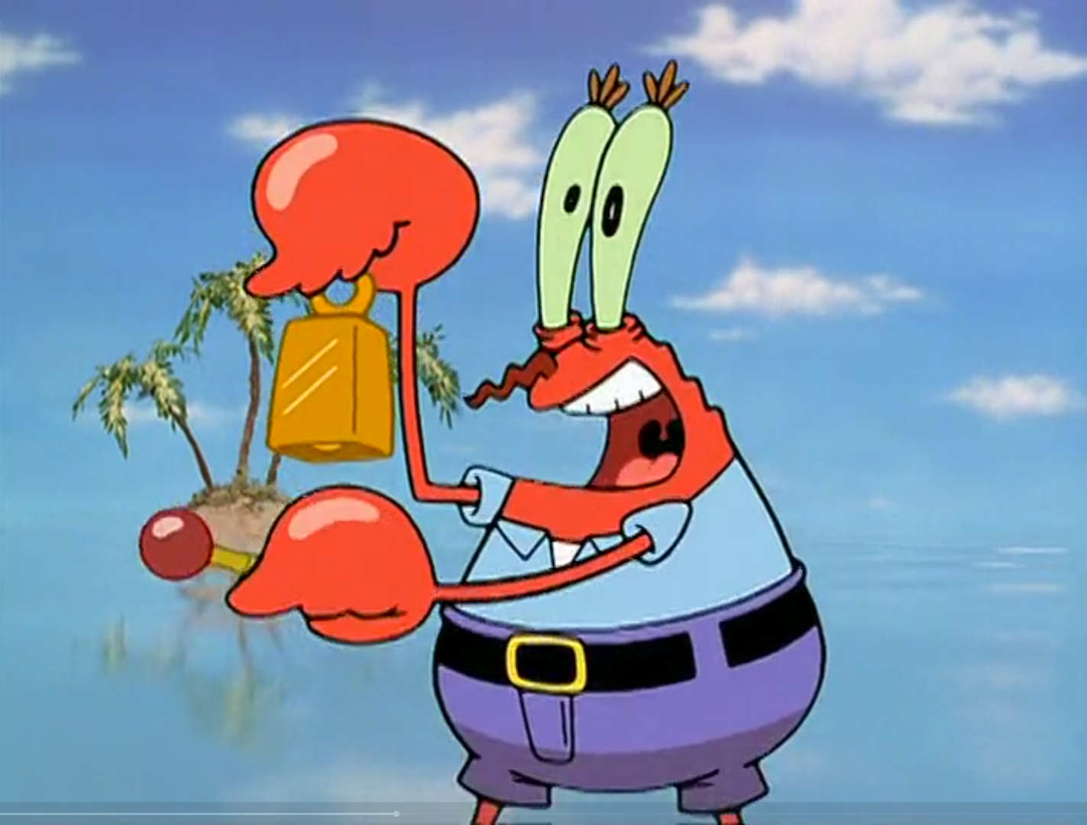
GIVE IT UP FOR LESSON 15

Slide 5
A DEEP DIVE INTO LISTS
WHY LISTS?
Ultimately, it’s because a list of 20 elements takes a lot less code than 20 individual variables
Lists can hold a variable number of items, making them flexible in use
List can be used to represent real-world concepts well
Roll call sheets, instructions, ingredient lists, grades, and so much more

Slide 6
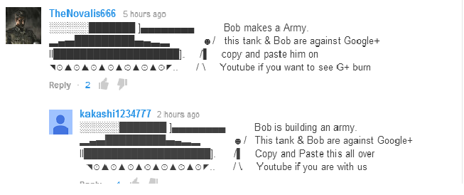
A DEEP DIVE INTO LISTS
LIST USES
Lists can be used to store strings for ASCII art

Slide 7
A DEEP DIVE INTO LISTS
LIST USES
picture = [“@@@@@@@@@@@@”,
“@@@@ @@ @@@@”,
“@@@@ @@ @@@@”,
“@ @@@@@@@@ @”,
“@ @”,
“@@@@@@@@@@@@”]
for i in range(len(picture)):
print(picture[i])

Slide 8
A DEEP DIVE INTO LISTS
LIST USES
Lists can be used to store inventory items for a text-based adventure game
inventory = [“flashlight”, “food”]
userSelection = input(“Would you like to pick up the screwdriver?”)
if userSelection == “Yes”:
inventory.append(“screwdriver”)
print(“You picked up the screwdriver”)
else:
print(“You decided not to pick up the screwdriver”)

Slide 9
A DEEP DIVE INTO LISTS
LIST USES
Lists can be used to store inventory items for a text-based adventure game
userSelection = input(“Would you like to open the vent?”)
if “screwdriver” in inventory and userSelection = “Yes”:
print(“You opened the vent, it looks kinda spooky.”)
elif userSelection = “Yes”:
print(“You need a screwdriver to open this vent.”)
else:
print(“You turned away from the vent.”)

Slide 10
A DEEP DIVE INTO LISTS
LIST USES
In this case, a list is used more as a set
Sets are collection of objects with no specific order, like the inventory of a game like this
It doesn’t matter the order of the items in our bag for the function of the game
The list can still be sorted and have that not matter as a factor

Slide 11
A DEEP DIVE INTO LISTS
LIST USES
Store a list of names, or other information
In my fish game, the fish objects for each tank is stored in a list
All the game’s tanks are stored in a big game-wide list
Each music track name is stored in a list
All the decorations for each tank are stored in a list
In hypothetical, can be used to store dice rolls for a dice game, characters in a party, a list of websites, and so much more

Slide 12
A DEEP DIVE INTO OBJECTS
OBJECTS
Objects are a custom type of variable that hold other variables and procedures to interact with that data
Objects are abstractions of real-world objects with variables that represent traits of that real world object

Slide 13
A DEEP DIVE INTO OBJECTS
OBJECT EXAMPLE
class Person:
def __init__(self, name, age):
self.name = name
self.age = age
def introduce(self):
print(“Hello, I’m ”, self.name, “ and I’m ”, self.age, “ years old!”
p1 = Person(“Brody”, 12)
p1.introduce()

Slide 14
A DEEP DIVE INTO OBJECTS
OBJECT EXAMPLE
Let’s break it down a bit more
class Person:
This is our class declaration
Similar to a procedure declaration
We decide the name of the class, and therefore the objects as well

Slide 15
A DEEP DIVE INTO OBJECTS
OBJECT EXAMPLE
def __init__(self, name, age):
self.name = name
self.age = age
This is our constructor (aka constructor method, constructor procedure)
Uses keyword __init__ short for initialize
Always has self in parenthesis, other two variables are brought in
self.name and self.age are assigned to values brought in
name and age are now variables in our class

Slide 16
A DEEP DIVE INTO OBJECTS
OBJECT EXAMPLE
def introduce(self):
print(“Hello, I’m ”, self.name, “ and I’m ”, self.age, “ years old!”
This is a procedure in our class
This one prints out information about the object, using the variables we created in our constructor

Slide 17
A DEEP DIVE INTO OBJECTS
OBJECT EXAMPLE
p1 = Person(“Brody”, 12)
p1.introduce()
We create a specific instance of our class called an object through instantiation
We give it information that goes to the __init__ procedure
We store it just like a variable
We can then call the object’s procedures by saying the object variable name, followed by a dot, followed by the procedure name

Slide 18
A DEEP DIVE INTO OBJECTS
OBJECTS
Multiple of each object can be constructed, and each procedure in them can be called multiple times
Objects can also be put into lists
Real code can be put into object procedures, it’s Python just like everything else
Objects can contain other objects as variables within themselves

Slide 19
A DEEP DIVE INTO OBJECTS
OBJECTS
Think about an object that you interact with and some variables that it might have, as well as some procedures it might have.
Try to write it to have at least 5 variables (data fields) and 3 procedures (methods)

Slide 20
A DEEP DIVE INTO OBJECTS
My object
Fish Object
Variables
Base Movement Speed
Water Type
Name
Color
Position (X, Y, Z)
Procedures
Swim()
Feed()
Relocate()

Slide 21

A DEEP DIVE INTO OBJECTS
Vocab to remember
Object
Class
Abstraction
Instantiation

